Slide 1
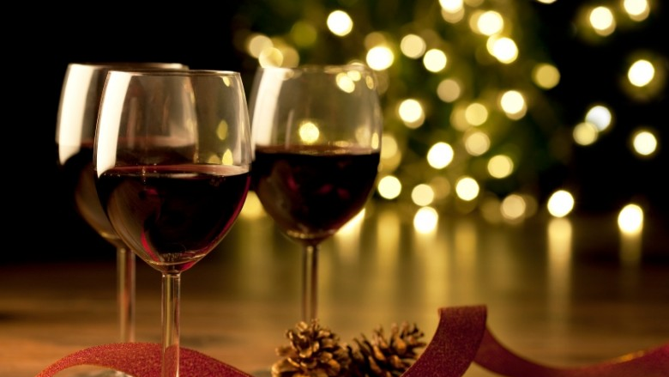

Analyzing Wine Reviews Using Text Analytics and Machine Learning
FORDHAM SOMMELIER
BYGB/ISGB 7977: Text Analytics
Final Project
GROUP 10: CHARLES OWENS, ILA SRIVASTAVA, SRAVYA KATTA, KATIE LINH CAO, YI QIAN

Slide 2
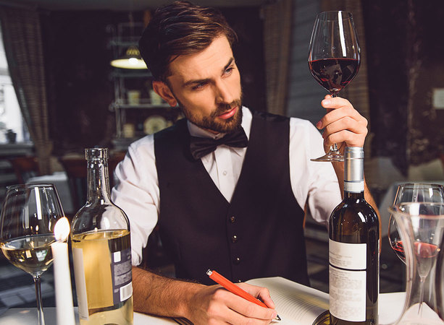
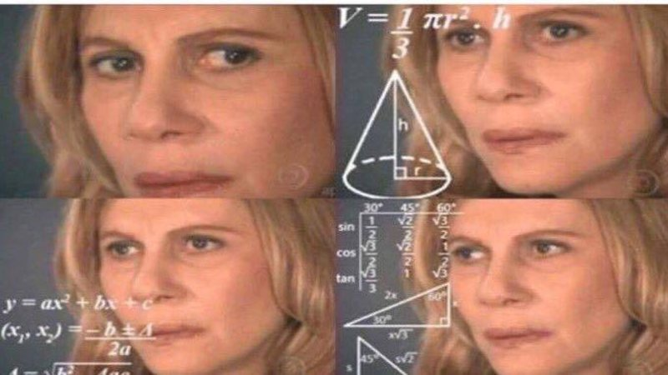
BACKGROUND
Wine is an alcoholic beverage made with the fermented juice of grapes.
Wine tasting is the sensory observation and appraisal of wine. Wine reviews usually describe the flavors, aroma, comparing to other non-grape fruit or aromas and flavors such as citrus, honey, leather.
We want to perform exploratory analysis on a relatively large dataset on wine reviews.
Our analysis will help us determine the main criteria through which a quality in wine is determined by testing various features such as price, rating, review, region, etc.

Slide 3
WHAT WE PROPOSE TO DO
Our primary goal is to rank the wines based on sentiment score derived from reviews and the points given to each wine by wine enthusiasts.
Secondly, based on that sentiment rank, we would try to identify the top three countries, regions, and provinces from which the most popular wines are produced and perform text analysis specifically on each of those top countries.
We will also identify the most popular wine varieties based on the reviews given to each wine.
Finally, we would like to build a machine learning model that can predict the variety of a wine based on the review description.

Slide 4
HYPOTHESES
Wine price is positively correlated with the higher rank given to review.
Popular wine producing countries (such as France, Italy) are likely to produce higher ranked wines.
Wines with the perfect score i.e., 100 also have the best sentiment score.
Better ranked wines also have a positive correlation with longer description.

Slide 5
DATA DESCRIPTION
Our dataset is a list of 129,971 reviews of different wines around the world by professional wine tasters at Wine Enthusiast, one of the preeminent wine magazines. The data was scraped from winemag.com during the week of June 15th, 2017.
Variables | Meaning
country | Country where the wine is from
description | Review of the qualities of the wine
designation | Vineyard within the winery where the grapes that made the wine are from
points | Number of points Wine Enthusiast rated the wine on a scale of 1-100 (though they say they only post reviews for wines that score >=80)
price | Cost for a bottle of the wine
province | Province or state that the wine is from
region_1 | Wine growing area in a province or state
region_2 | Sometimes there are more specific regions specified within a wine growing area
taster_name | Name of wine taster
taster_twitter_handle | Twitter handle of wine taster
title | Title of the wine review, which often contains the vintage
variety | Type of grapes used to make the wine
winery | Winery that made the wine

Slide 6


METHODOLOGY
Data Collection/ Preprocessing
Sentiment Analysis Using Vader
Tokenization
Stopword Removal
- Stemming
- POS tagging
- N-grams
Analysis + Evaluation
Classified into Positive/Negative/Neutral
Assign rank based on sentiment score
Identify top three countries: France, Portugal, US
Data Preprocessing
Variable Selection
Building ANN Model
Analysis + Evaluation

Slide 7
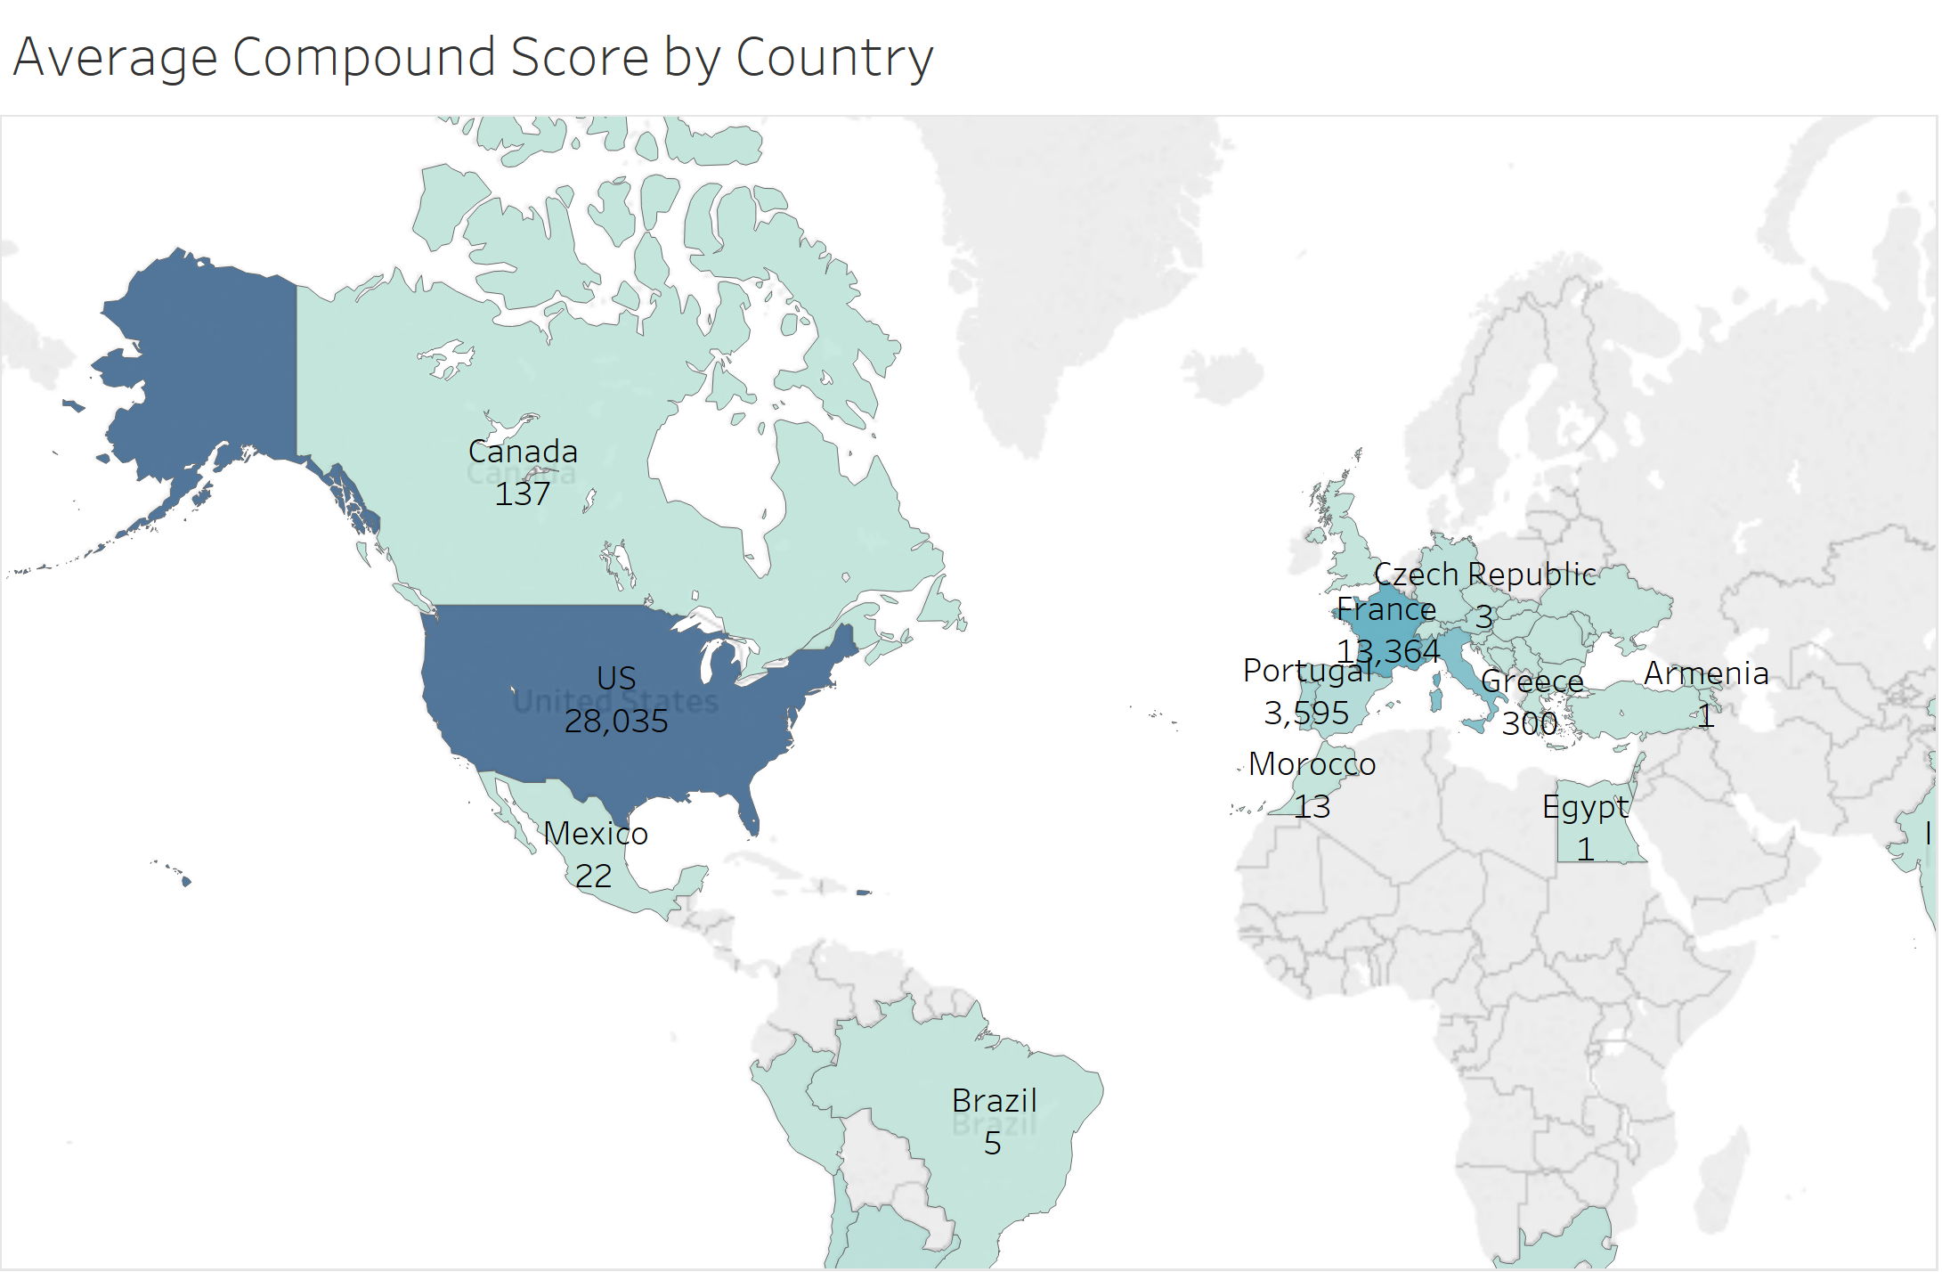
RESULTS & DISCUSSION – Top three countries
Vader Compound Score by Countries

Slide 8
RESULTS & DISCUSSION – Top three countries
 | France | Portugal | United States
Tokenization | Words like and, a, with, wine have higher frequencies. | Words like a, with, and, is have higher frequencies. | Words like flavors, and, a, clean have higher frequencies.
After stopword removal | After stopword reduction we can see France wines have characteristics like fresh, acidity, bright, rich, lively, sweet. | After stopword reduction we can see Portugal wines have characteristics like sweet, rich, lightly, etc. | After stopword reduction we can see US wines have characteristics like pleasant, rich, aromatic etc.
Stemming | Helps in retaining root word like acid, sweet, rich, fine | Helps in retaining root word like light, rose. Rosé wine is preferred. | Helps in retaining root word like soft, clean, aroma, pleasant, spice etc.
POS tagging | Apple, plum, grapefruit, strawberry are among noticeable words. | Rose and vanilla are famous ones. Texture of wines is good. | Melon, blackberry, orange, grapefruit appear to be top descriptors.
n-gram | “fine” and clean” - most common “intense” and “sparkling” “apple” and “barrel” “sweet” and “fruits” “delicious” and “sweet” | “easy” and “fresh” – most common “slightly” and “sparkling” “pleasant” and “soft” “lightly” and “sweet” | “honey” and “orange” – most common “vanilla” and “flavors” “rich” and “balanced” “elegant” and “clean”

Slide 9
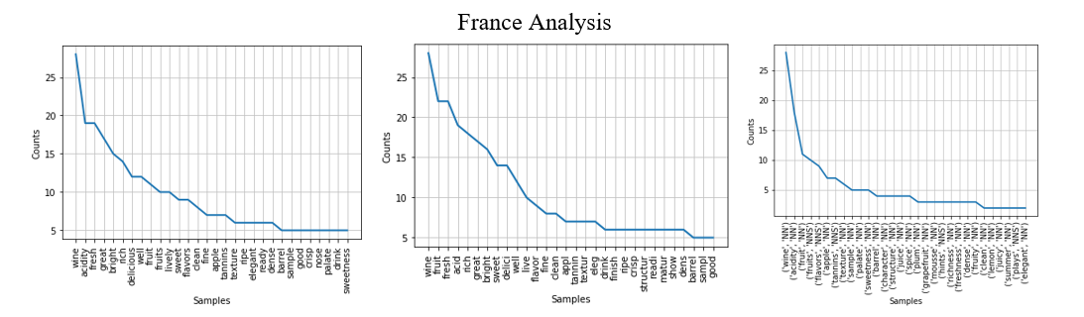
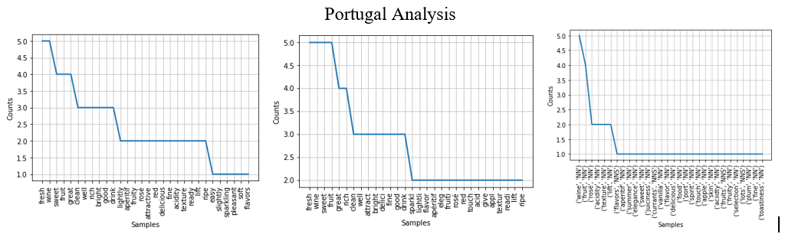
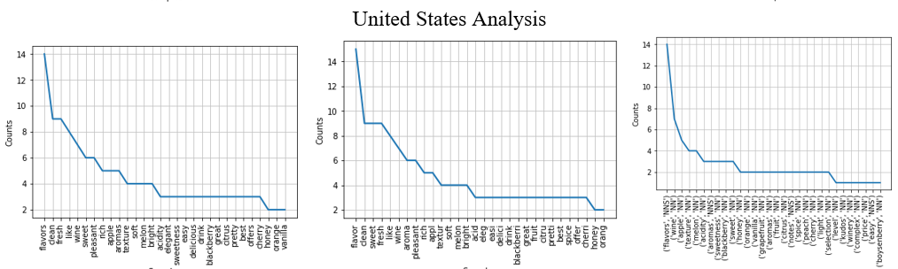
RESULTS & DISCUSSION – Top three countries
From left to right: Subplots showing word frequency of Tokenization after Stopword removal, Stemming, POS tagging

Slide 10
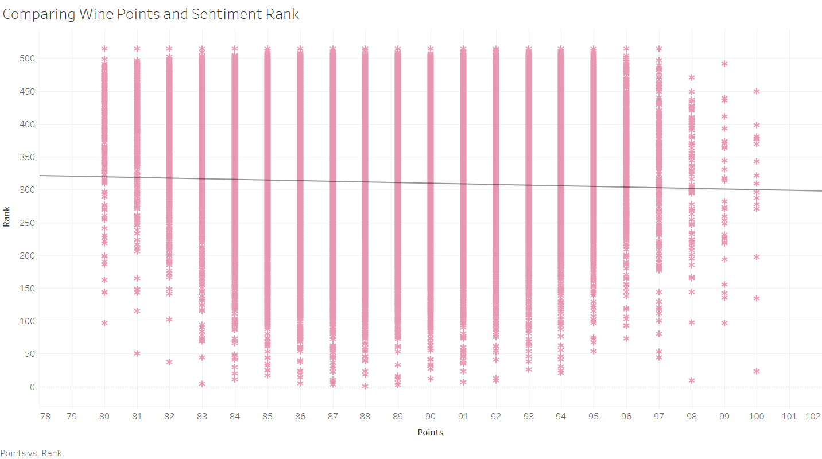
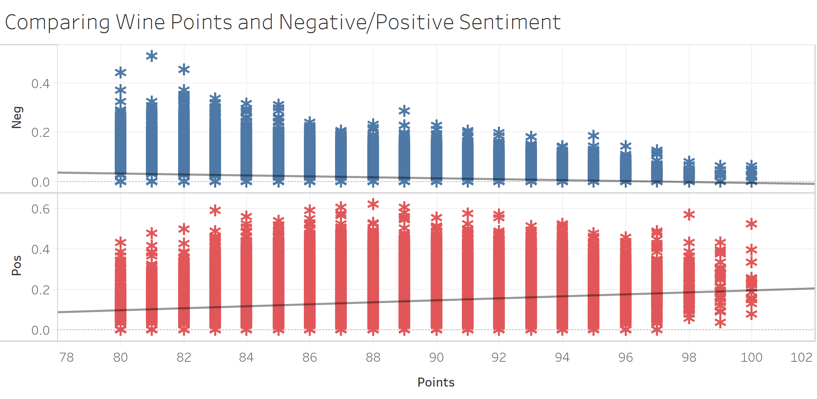
RESULTS & DISCUSSION – Visualization and Analytics
Comparing Wine Points and its Corresponding Sentiment Ranking
Comparing Wine Points and its Negative/Positive Sentiment

Slide 11
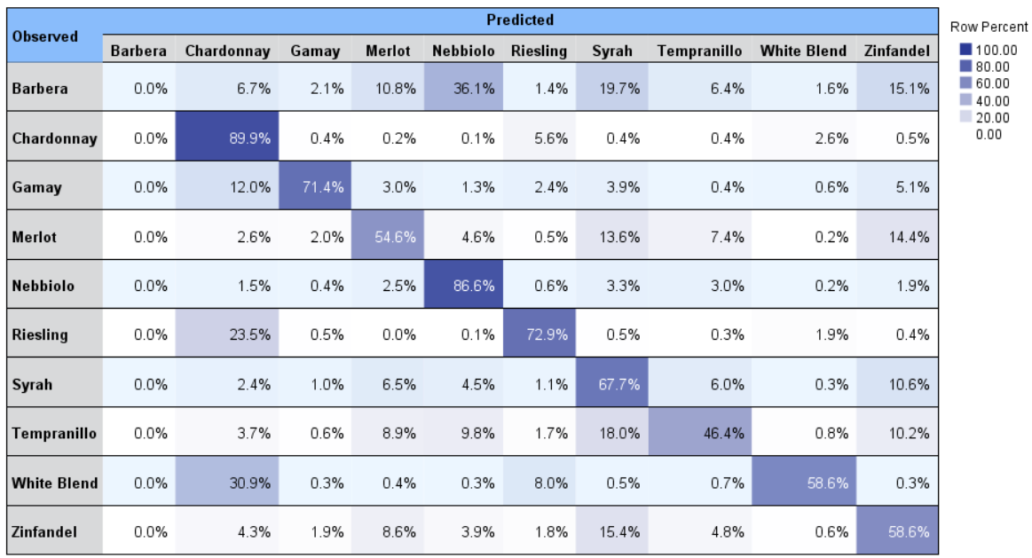
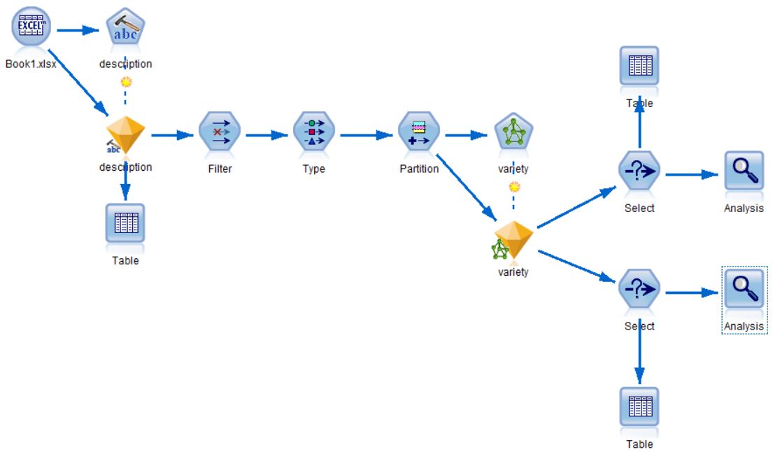
RESULTS & DISCUSSION – Machine Learning Model - ANN
Model Stream in SPSS Modeler
Prediction Accuracy for top 10 Wine Varieties

Slide 12
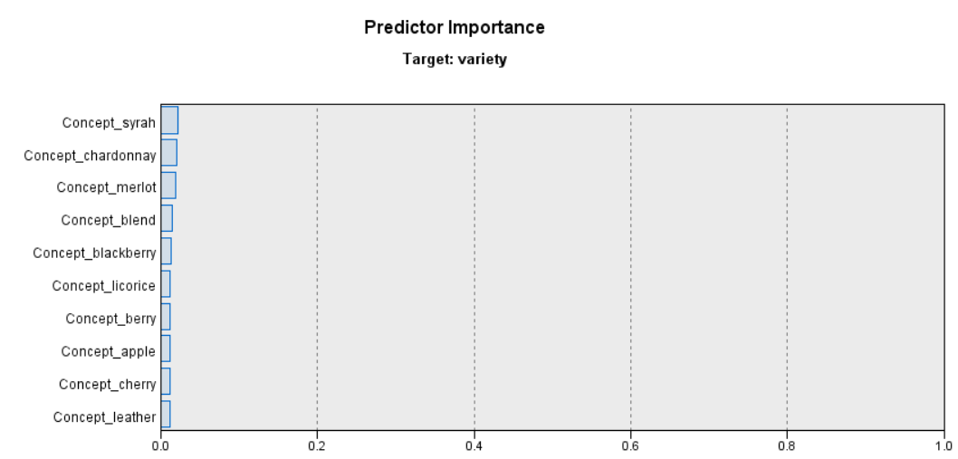
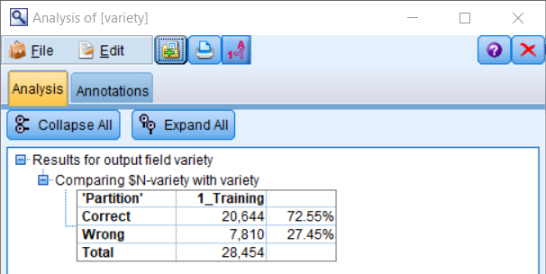
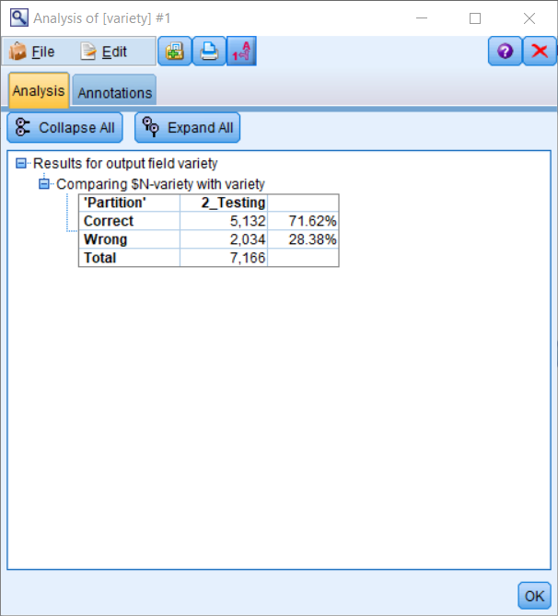
RESULTS & DISCUSSION – Machine Learning Model - ANN
Accuracy on Training and Testing Data
If wine review contains the name of wine variety, it would increase the accuracy of the prediction
If wine review contains common descriptors like fruits and material, it would also be more accurate to predict the wine variety.

Slide 13
CONCLUSION
Initial Hypotheses & Machine Learning Model
Interesting Findings About Wine
The top 10 wine varieties are White Blend, Riesling, Chardonnay, Merlot, Gamay, Zinfandel, Syrah, Nebbiolo and Barbera.
France, Portugal, and the United States frequently produce the top ranked wines. Our hypothesis related to France producing top wines has been satisfied, yet Italy does not rank high.
Some of the most popular wines are Domaine Huët 2005 Pétillant (Vouvray), Château Haut-Simard 2009 Barrel sample (Saint), Straight Line 2011 Sauvignon Blanc.
Provinces that produce highly-preceived and highly-ranked wines are Loire Valley, Bordeaux, California and Vinho Verde, to name a few.
French wines are usually described as fresh, acidity, bright, rich, lively, sweet whereas American-produced wines as pleasant, rich, and aromatic.
Most of the top ranked wines are not considered expensive.
Wines with high negative sentiment scores are also given low points.
No significant correlation found between positive sentiment score/sentiment rank and wine points.
Neural network model predicts wine variety well, with an accuracy of 71.62%
Important predictors for wine variety are common sensory descriptors like blackberry, apple and cherry.

Slide 14
FUTURE RECOMMENDATION AND FURTHER EXPLORATION
Recommendation
Further Exploration
Wine tasting- a subjective topic not backed by scientific research yet embedded in the culture and history all over the world
What contributes to a popular wine variety and what drives the rating and the sentiment of wine tasters based on hundred thousand of reviews
A professional sommelier: learn from other sommeliers with a large scale, fine-tune the art of food and wine pairing.
A wine buyer: navigate through the delicacy of wine varieties and make a purchase without having to taste it.
Availability of data from other magazines beside WineMag and professional sommelier networks
Further deep-dived sentiment analysis into:
The different vintages of one variety (vertical wine tasting)
Same vintage of different wine varieties (horizontal wine tasting)

